Slide 1
How C++ Breathes on Bare Metal
Raspberry Pi Pico (RP2040) and the ESP 32D

Slide 2
The Basics of Bare Metal
When the term “bare metal” was originally coined, its meaning was very literal. All software written to run on bare metal computers was designed to interact directly with an underlying hardware.
In other words, it literally worked on bare metal.
In summary, metal refers to physical hardwares either a cloud server, laptops, microcontrollers, or any network device.

Slide 3
Why C++ Fits Bare Metal Programming
C++ offers a balance between abstraction and control
Zero-cost abstractions
Strong type safety
RAII for safe resource management

Slide 4
Continuation
Cross-platform toolchains
Ability to write close-to-hardware logic when needed.
Modern C++ practices that makes life easier and software better.
Requires knowledge of the hardware.

Slide 5
Types of Microcontrollers and their Uses

Slide 6
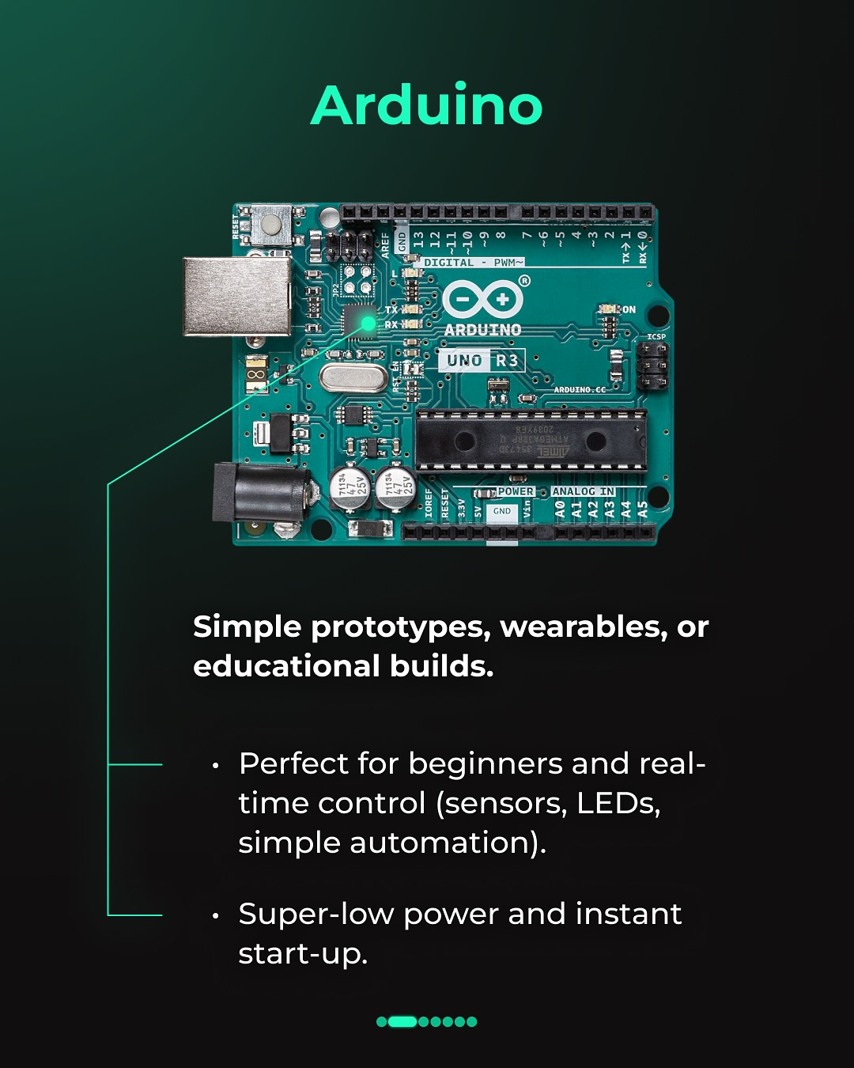

Slide 7
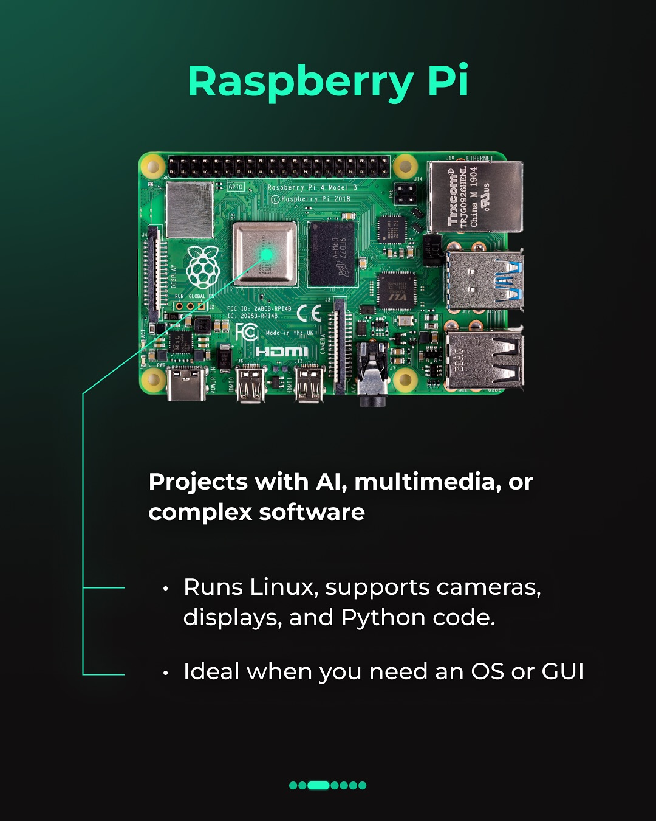

Slide 8
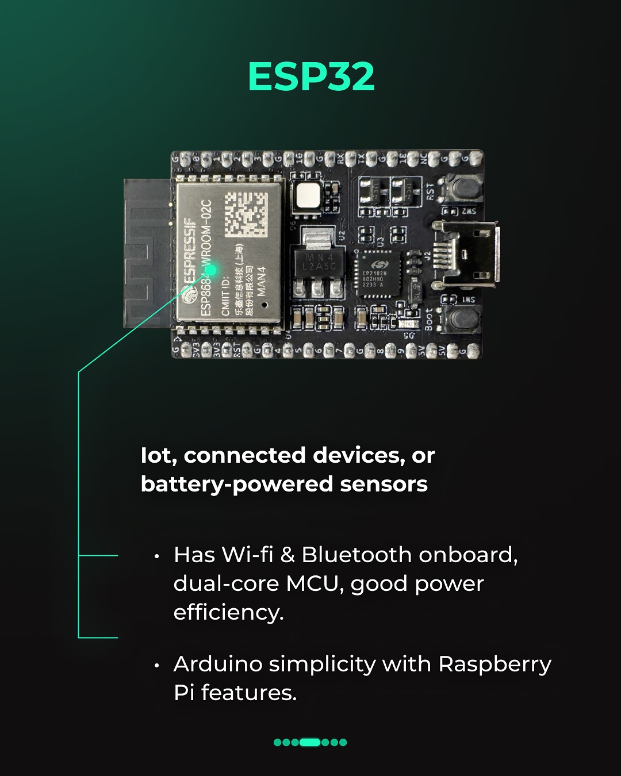

Slide 9
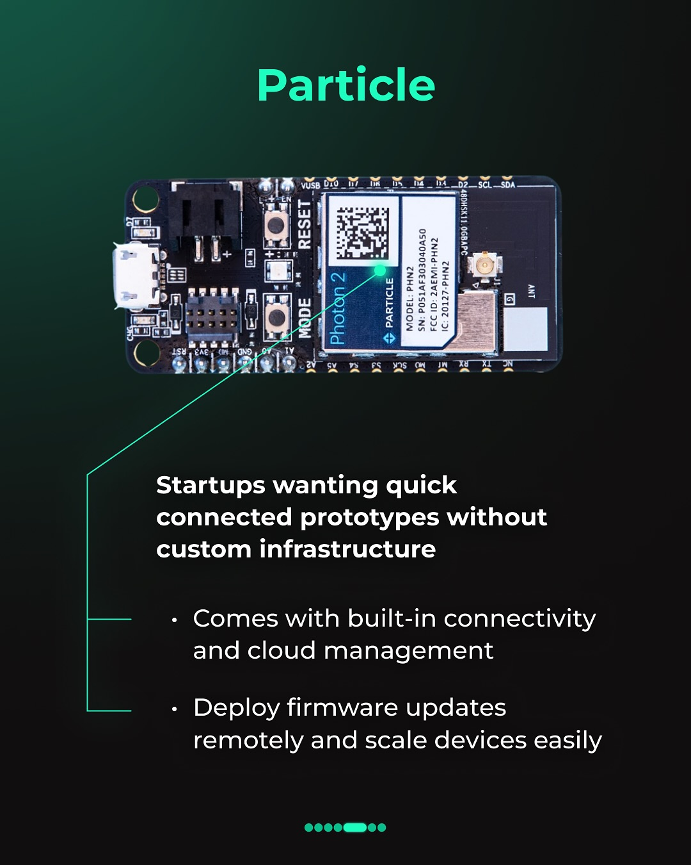

Slide 10
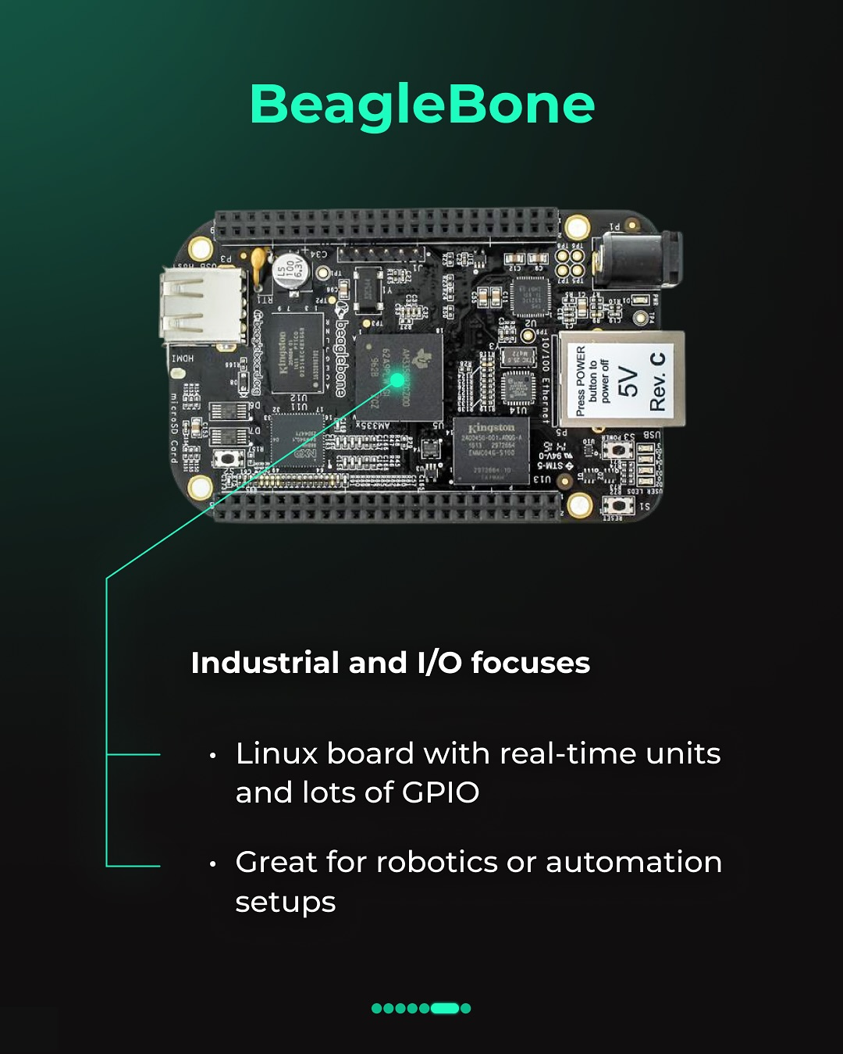

Slide 11
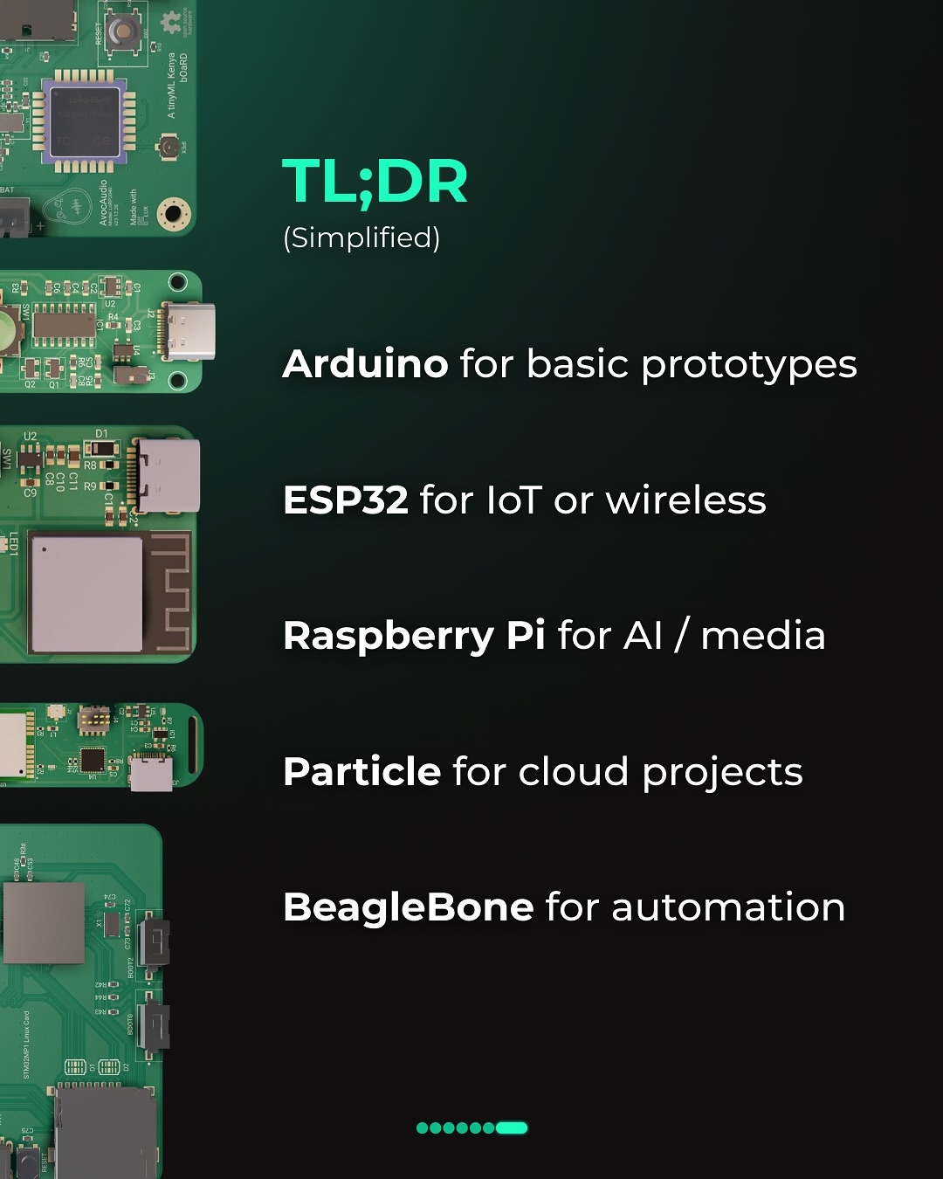

Slide 12
There are many more microcontrollers such as NanoPi, OrangePi, BananaPi and many more.
Available on Local Stores

Slide 13
RP2040 Overview
RP2040 is a microcontroller designed by Raspberry Pi, and its name breaks down as follows:
R for Raspberry Pi,
P for Pi,
2 for the dual-core processor,
0 for the Arm Cortex-M0+ CPU type, and
40 indicates the amount of RAM on the chip

Slide 14
contd.
Budget friendly less not $3
Dual-core ARM Cortex-M0+, up to 133MHz
264kB of embedded SRAM in 6 banks
Programmable I/O (PIO) for extended peripheral support(UART,
30 multifunction usable GPIO pins
Runs code directly from flash
Your code = runs the hardware directly.

Slide 15
Raspberry Pi Pico microcontrollers
RP2040 microcontroller: This is the official microcontroller designed by Raspberry Pi, based on a dual-core ARM Cortex-M0+ processor. It is the brain of the Pico series.
Raspberry Pi Pico: The original microcontroller board based on the RP2040 chip.
Raspberry Pi Pico W: A Pico board with added wireless connectivity (Wi-Fi and Bluetooth).
Raspberry Pi Pico H: The "H" stands for "header," meaning this version comes with pre-soldered headers.
Raspberry Pi Pico WH: A version of the Pico W with pre-soldered headers

Slide 16
Other devices
Raspberry Pi (Model B, 4, 5, Zero 2 W): These are typically single-board computers (SBCs), which are more powerful than microcontrollers and can run full operating systems like Linux. They are based on microprocessors, not microcontrollers, although they have GPIO pins that can be used for microcontroller-like tasks.

Slide 17
ARM vs. Intel Processors
Arm and Intel are two companies that design processors used in most electronics today. Arm processors are known for their power efficiency in portable devices,
while Intel are known for its high-performance processors used in personal computers and servers.

Slide 18
Instruction Set
Both companies have their own ISA (Instruction Set Architecture), which they have exclusive access to use and license.
Intel’s ISA is known as the x86 architecture, which uses a CISC (Complex Instructions Set Computing) design philosophy. Arm’s ISA is the ARM architecture, which uses a RISC (Reduced Instruction Set Computing) design philosophy.

Slide 19
Software Compatibility/Support
Since the x86 and ARM ISAs are based on two very different design philosophies (RISC and CISC), software made for Intel chips cannot be processed natively by an ARM processor and vice versa. Having most programs developed on a specific architecture ensures that consumers will buy a company's processor whose applications is available to them.

Slide 20
Common ARM Processor Families
Cortex-M Series : For microcontrollers (low power, real-time control)
Cortex-R Series : For real-time systems (e.g., automotive, robotics)
Cortex-A Series : For application processors (e.g., smartphones, tablets)
Neoverse : For infrastructure and cloud computing
Apple Silicon (e.g., M1, M2) : Custom ARM-based processors for Macs

Slide 21
Getting Started on your Unix Machine
The Raspberry Pi Pico SDK provides lightweight C and C++ support libraries that allow C++ code to run directly on the hardware.
- A Unix machine
- clone : https://github.com/raspberrypi/pico-sdk
- USB type C cord

Slide 22
Getting Started on your Unix Machine
Install:
CMake
GCC ARM Toolchain
Visual Studio Code integration
Pico SDK

Slide 23
Getting Started on your Unix Machine
sudo apt install cmake python3 build-essential gcc-arm-none-eabi libnewlib-arm-none-eabi libstdc++-arm-none-eabi-newlib

Slide 24
Prepare your Pico SDK
Create a directory called “Pico”
“mkdir pico”
/home/dencomac/pico/
Move your pico sdk into it the folder
Create another directory where your projects will reside “mkdir myprojects”

Slide 25
Directory Structure
Inside pico directory:
/home/dencomac/pico/
_________ pico-sdk/ the SDK (shared by all projects)
_________ myprojects/
|__________ blink_simple/
|___________CMakeLists.txt, blink_simple.cpp, build/

Slide 26
What CMake Actually Is
CMake is not a compiler.
It’s a build system generator — it creates all the files and commands needed to compile your project using your chosen compiler and tools (in this case, the ARM GCC toolchain for the RP2040).
So instead of writing a massive Makefile by hand, you write a short CMakeLists.txt file, and CMake:
Reads it
Pulls in all dependencies from the Pico SDK
Sets up the cross-compilation for the RP2040 (ARM Cortex-M0+)
Generates the proper Makefiles that can build .elf, .bin, and .uf2 files.

Slide 27
Build your CMAKE Project
Run this commands in the /build directory
cmake .. -DPICO_SDK_PATH=/home/dencomac/pico/pico-sdk -DCMAKE_EXPORT_COMPILE_COMMANDS=ON
make -j4 (for faster compilation)

Slide 28
-DCMAKE_EXPORT_COMPILE_COMMANDS=ON is an optional CMake flag that tells CMake to generate a file called: compile_commands.json
Useful for IDEs & editors to provide correct C/C++ tooling

Slide 29
What happens after “make” is entered
Compile
Each .c or .cpp file → .o (object file) Blink.o
Link
All .o files → single .elf (Executable and Linkable Format) blink.elf
Convert
.elf → .bin (raw binary) blink.bin
Package
.bin → .uf2 (USB Flashing Format) blink.uf2

Slide 30
How a Pico Program Starts Running
You compile your program into a UF2 file
You put the Pico in bootloader mode (BOOTSEL button)
You drag and drop the UF2 file to the mounted drive
The bootloader writes the firmware into flash memory
After reset, the RP2040 reads your program from flash and runs main()
There is no OS. Your code is the firmware.

Slide 31
END

